Slide 1
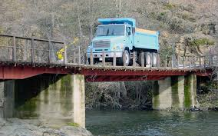
Bending Moment and Shear Force Diagrams 28 March 2017 Atul JAIN

Slide 2
Analysis of Beams
Beams are commonly used structural members
Characteristics of beams
- Long
- Straight
- Usually subject exclusively to normal loading
Typically made of Steel, Aluminum in modern applications, wood was the favored material historically

Slide 3
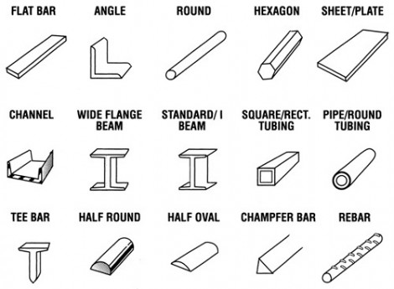
Classification of beams
According to cross-sectional shape

Slide 4
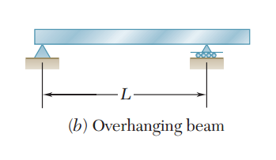
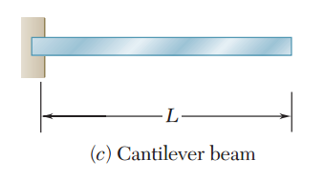
According to support
Three major types of statically determinate beams- to be considered today

Slide 5
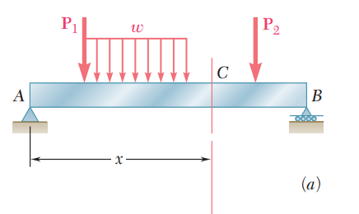
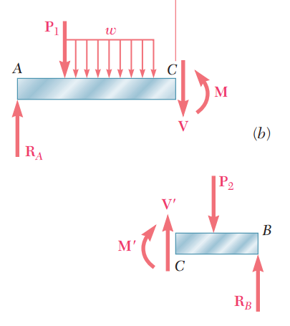
Shear Force and Bending Moment
Imagine a randomly loaded beam
Let us make a section a point C
Drawing FBD for both sides of the section
There is Shear force V and Bending moment M
The value of V and M would depend on where “C” was chosen
The plot of V and M as a function of x is shear force and bending moment diagram

Slide 6
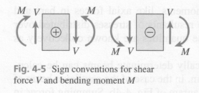
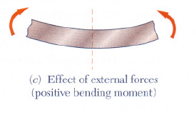
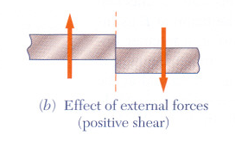
Sign Convention
The shear is positive (+) when external forces acting on the beam tend to shear off the beam at the point indicated in fig
The bending moment is positive (+) when the external forces acting on the beam tend to bend the beam at the point indicated in fig

Slide 7
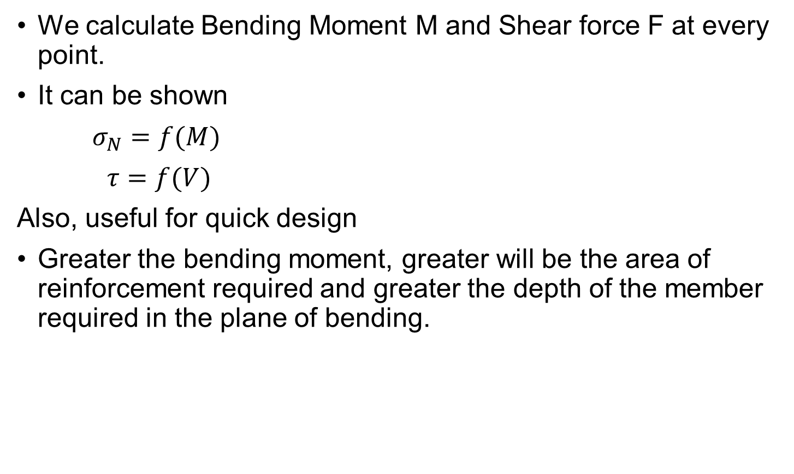
Why BM and SF are important?
We calculate Bending Moment M and Shear force F at every point.
It can be shown
$σ_{N}=f(M)$
$τ=f(V)$
Also, useful for quick design
Greater the bending moment, greater will be the area of reinforcement required and greater the depth of the member required in the plane of bending.

Slide 8
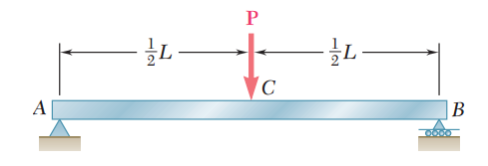
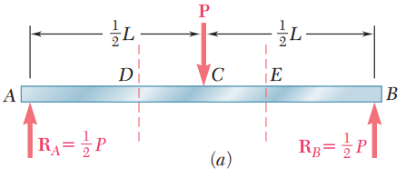
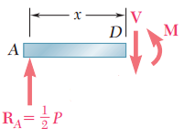
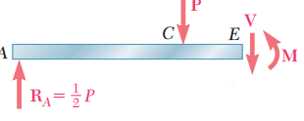
How to draw BM and SF
Step 1: Calculate the reactions at A and B
Step 2: Draw a section at before every load discontinuity
Step 3: Going left to right draw the FBD of each section
Step 4: Calculate and plot V, M as a function of x for each section
Section AD:
V = ½ P
M= ½ Px
Section AE:
V = -½ P
M= ½ P(L-x)

Slide 9
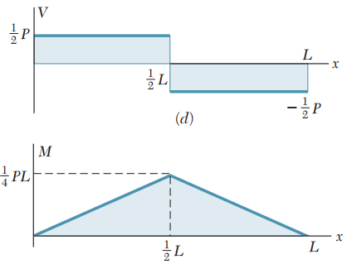
Section AD (D lies between A and C):
V = ½ P
M= ½ Px
Section AE (E lies between C and B):
V = -½ P
M= ½ P(L-x)
C
B
A

Slide 10
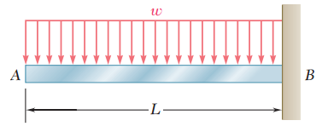
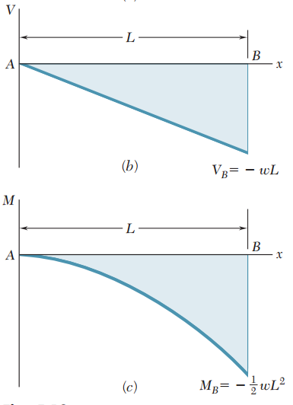
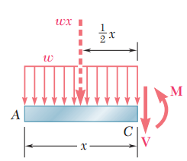
Distributed force
Force is continuous, any one section is enough
For distributed load, replace distributed force by concentrated force as shown
V = -wx
M = -1/2wx²

Slide 11
Common Relationships
Load | 0 | Constant | Linear
Shear | Constant | Linear | Parabolic
Moment | Linear | Parabolic | Cubic

Slide 12
Common Relationships
Load | 0 | 0 | Constant
Shear | Constant | Constant | Linear
Moment | Linear | Linear | Parabolic
M

Slide 13
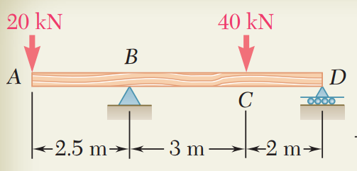
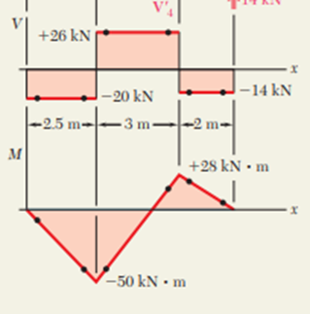
Problem I
Step 1: Calculate the reactions at A and B
Step 2: Draw a section at before every load discontinuity
Step 3: Going left to right draw the FBD of each section
Step 4: Calculate and plot V, M as a function of x for each section

Slide 14
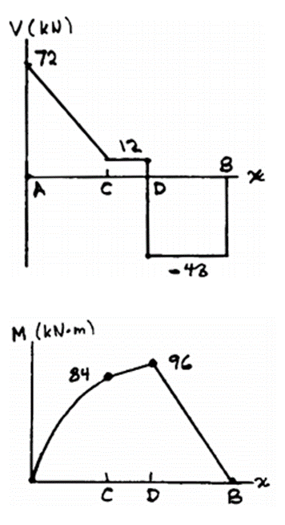
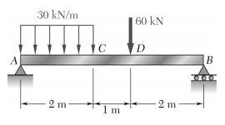
Problem II
Step 1: Calculate the reactions at A and B
Step 2: Draw a section at before every load discontinuity
Step 3: Going left to right draw the FBD of each section
Step 4: Calculate and plot V, M as a function of x for each section

Slide 15

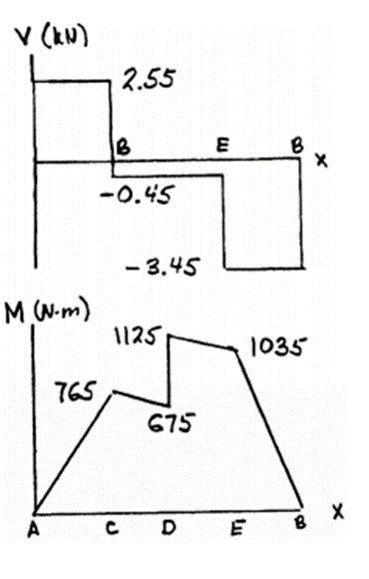
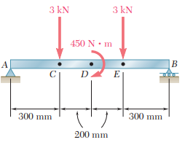
Problem III

Slide 16
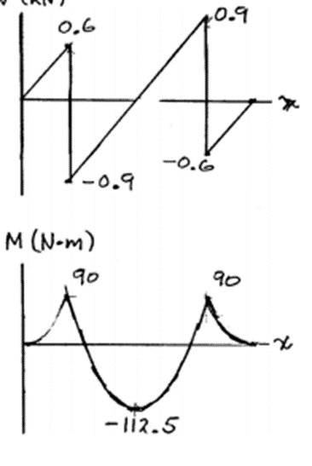
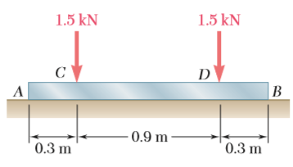
Problem IV
Q: Assuming that the reaction of the ground is uniformly distributed, draw the shear and bending-moment diagrams for the beam AB and determine the maximum absolute value (a) of the shear, (b) of the bending moment.

Slide 17
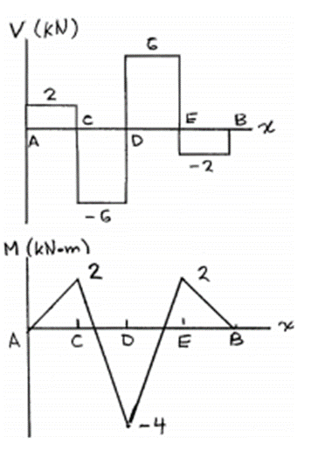
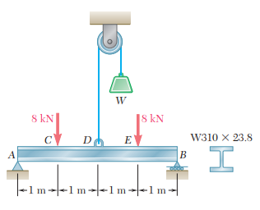
Problem V
Step 1: Calculate the reactions at A and B
Step 2: Draw a section at before every load discontinuity
Step 3: Going left to right draw the FBD of each section
Step 4: Calculate and plot V, M as a function of x for each section
W = 12kN

Slide 18
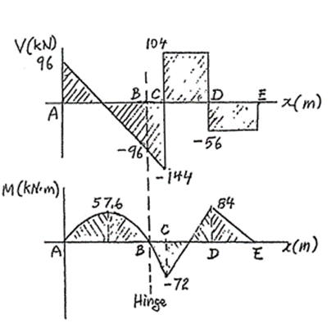
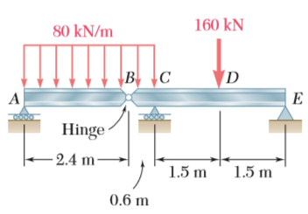
Problem VII
Step 1: Calculate the reactions at A and B
Step 2: Draw a section at before every load discontinuity
Step 3: Going left to right draw the FBD of each section
Step 4: Calculate and plot V, M as a function of x for each section

Slide 19
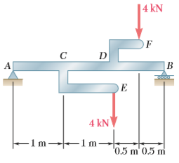
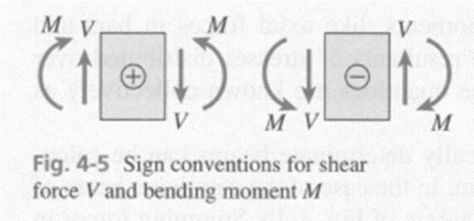
Problem VI
Step 1: Calculate the reactions at A and B
Step 2: Draw a section at before every load discontinuity
Step 3: Going left to right draw the FBD of each section
Step 4: Calculate and plot V, M as a function of x for each section
Q: Draw the shear and bending-moment diagrams for the beam and loading shown, and determine the maximum absolute value (a) of the shear, (b) of the bending moment.

